Slide 1
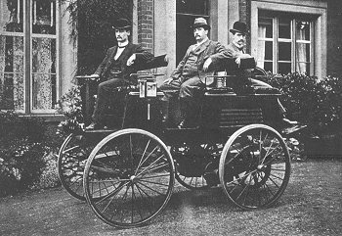
CHARGING INTO THE FUTURE WITH ELECTRIC CARS (NOT YOUR GREAT GREAT GREAT GRANDFATHER’S ELECTRIC CAR)
The first successful electric car made its debut around 1890 thanks to William Morrison, a chemist who lived in Des Moines, Iowa. His six-passenger electrified wagon vehicle was capable of a top speed of 14 miles per hour.
AND
Should Abel Buy an Electric Car? Inquisitive minds want to know …
Presented by The Tenacious Team:
Gabrielle Bedewi, Abel Habte, Francesca Palik
August 14, 2023

Slide 2
Topics
Background
Data Source and Data Prep Steps
Data Prep and Exploratory Analysis Steps
Overview of Alternative Fuel Stations
Interactive Visualizations of Electric Fuel Stations
Abel’s decision!
Q & A
Appendix - References

Slide 3
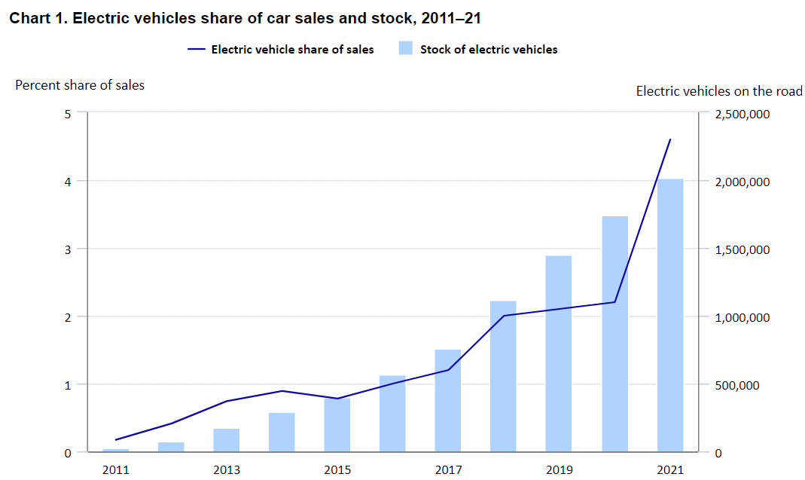
The Growing Electric Vehicle Market
The number of EVs on the road jumped from about 22,000 to a little over 2 million over the 2011–2021 decade.*
Several factors are expected to continue to drive consumer demand for EVs over the 2021–31 decade; such as, increased consumer interest, environmental concerns, government policies (The Infrastructure Investment and Jobs Act), buy-in from the auto industry with greater vehicle choices, improved battery capacity, and cost savings.
https://www.bls.gov/opub/btn/volume-12/charging-into-the-future-the-transition-to-electric-vehicles.
Notes:
The Infrastructure Investment and Jobs Act, signed into law in November 2021, allocated $7.5 billion to building out a nationwide charging network.¹² The funding has initially focused on installing fast chargers along the interstate highway system, which would help mitigate battery range fears and enable long-distance travel.¹³ The legislation also included large investments to upgrade the nation’s power grid—key for accommodating rising electricity demand as EV adoption grows—and to expand domestic battery production and recycling capacity.¹⁴ On the consumer side, tax credits spur demand. For instance, the Inflation Reduction Act, signed into law in August 2022, extended a tax credit of up to $7,500 for the purchase of new EVs until 2032 and provided, for the first time, that tax credits could be used for purchasing used EVs.¹⁵

Slide 4
Data Source and Data Prep Steps
https://developer.nrel.gov/docs/transportation/alt-fuel-stations-v1/get/
Dataset represents number of alternative fuel stations January 1, 1976 through July 11, 2023.
Data is updated on a monthly basis; last update occurred on 8/11/2023.
Fields included:
-Station ID
-Fuel Type
-Station Name & Address
-Station Status Code
-Station Access Code
-Station Open Date
-Facility Type
-Latitude
-Longitude
73,888 rows and 73 columns
73,888 rows and 27 columns
Selected pertinent fields (columns)
73,834 rows and 27 columns
Excluded British Columbia, Puerto Rico, Ontario, and Quebec (incorrectly assigned US State code)

Slide 5







Data Prep and Exploratory Analysis Steps
STEP 4 – Creating Interactive Dashboards and Maps (drop down, zoom, hover capabilities
Javascript, Leaflet, and Openstreetmaps
- Electric Stations by state
- Electric Stations by station status code (available, planned, temporarily closed)
- Electric Stations by type of access (private, public)
- Electric Stations by charging speed
STEP 3 – Creating Graphical Visualizations
Pandas
- Total # of Stations by fuel type over time
- Total # of Stations by state
- Total # of Stations by station status code (available, planned, temporarily closed)
- Total # of Stations by type of access (private, public)
- Total # of Stations by type of facility (convenience store, hotel, car dealer, …)
STEP 2 – Creating Descriptive Statistics
API routes using Flask
- Total # of stations by fuel type
- Total # of stations by station status code (available, planned, temporarily closed)
- Total # of stations by type of access (private, public)
- Total # of stations by state
STEP 1 - Getting & Cleansing the Data
- API call to the data source in Jupyter Notebook
- Pandas Dataframe to drop columns not of interest
- Exported Data into CSV & JSON & imported into MongoDB
- Pymongo to exclude non-US States and removed Zip Code column

Slide 6
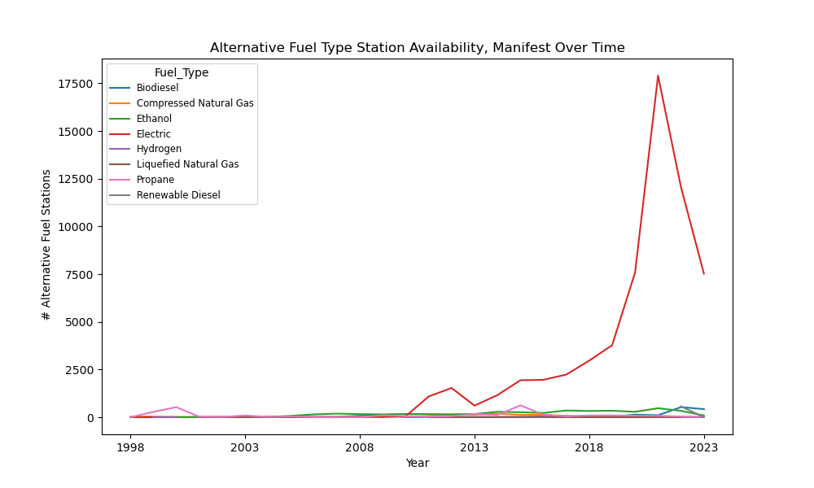
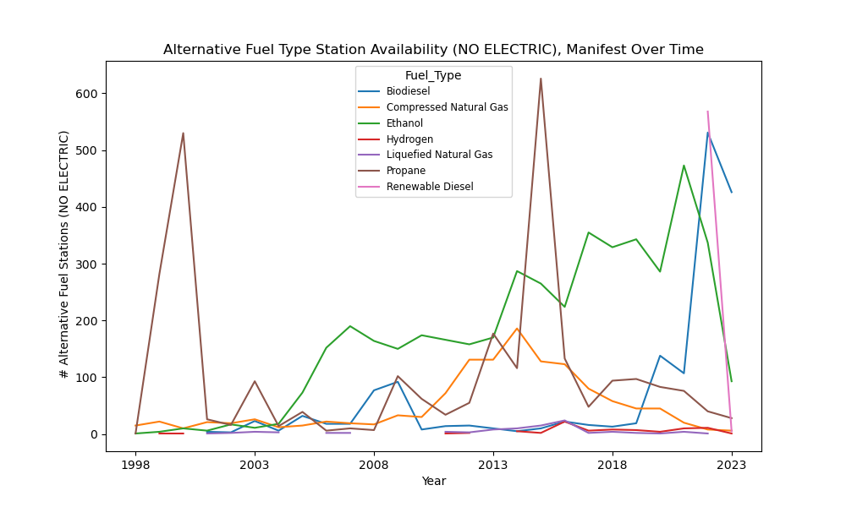
Overview of Alternative Fuel Stations Across the Years
Pre-1990 stations were pre-dominantly Propane.
Electric stations emerged around the mid 90’s, with spike occurring in 2021 triggered by The Infrastructure Investment and Jobs Act.
Increased demand for Ethanol after 2003.

Slide 7
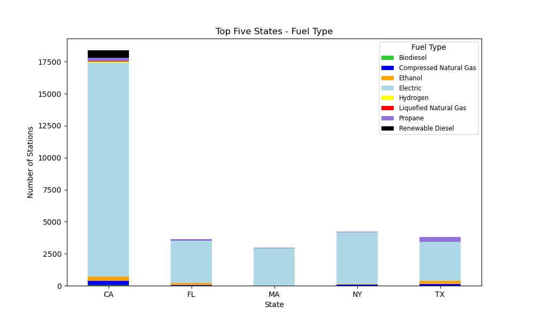
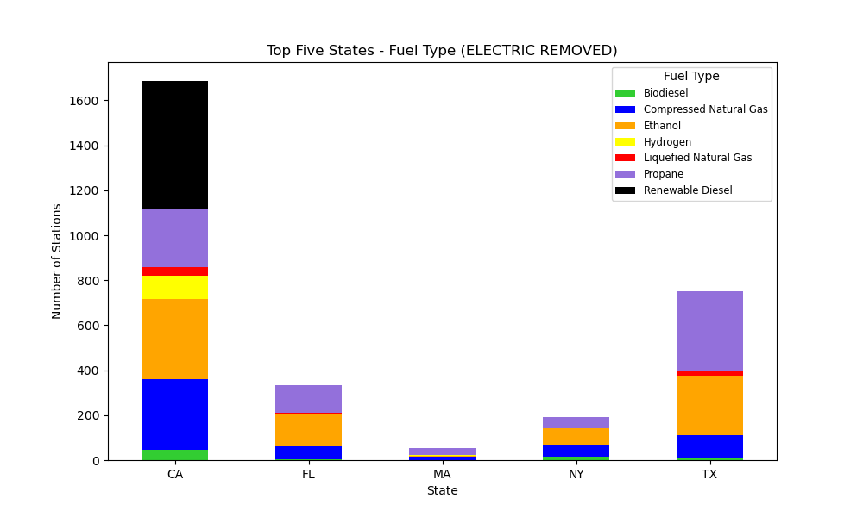
Overview of Alternative Fuel Stations Across the Top 5 States
Top 5 ranked states by area: Alaska, Texas, California, Montana, New Mexico
Top 5 ranked states by population: California, Texas, Florida, New York, Pennsylvania
State of California has overwhelmingly the largest demand for all the different types of alternative fuel.

Slide 8
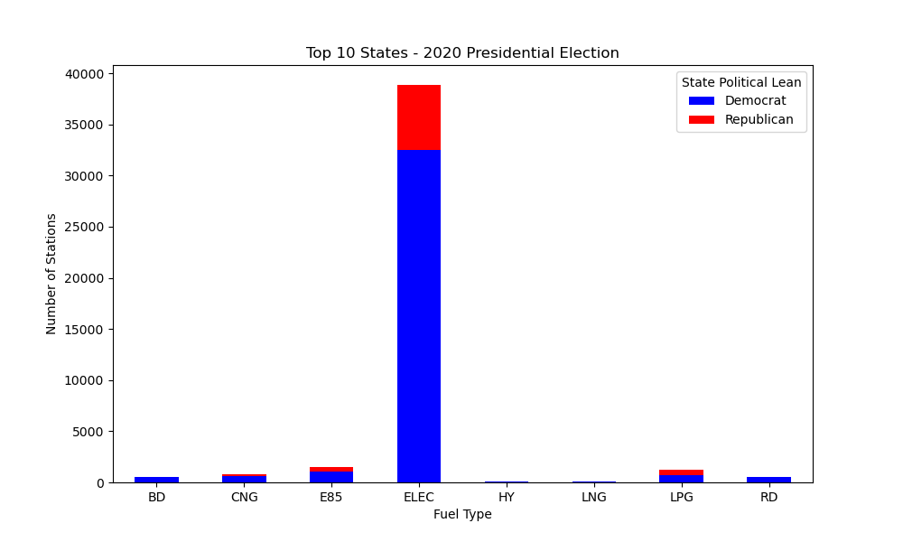
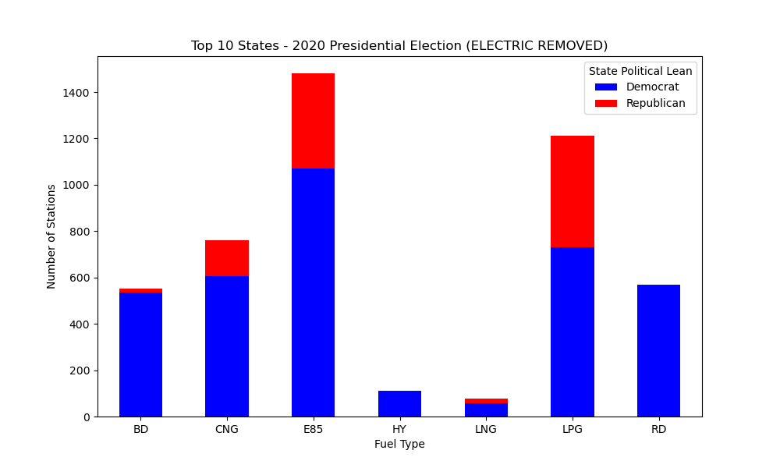
Overview of Alternative Fuel Stations Across Political Party Affiliations
There is a positive relationship between the demand for alternative fuel across the top 10 states (based on # of stations) and political party affiliation of that state.

Slide 9
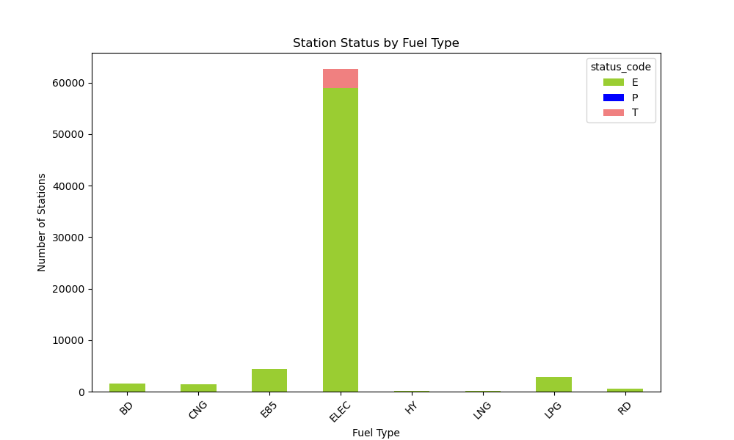
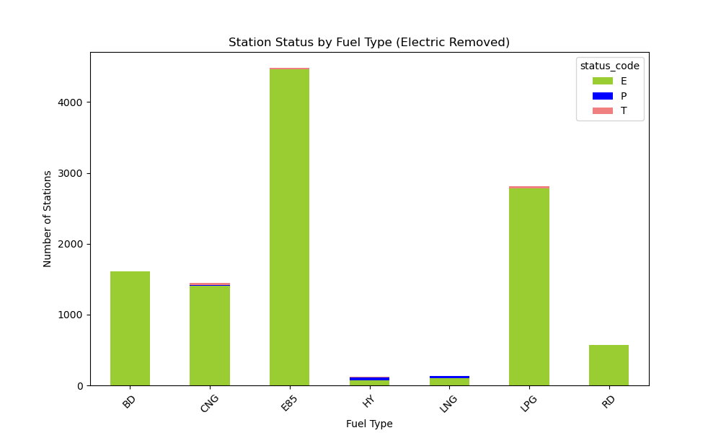
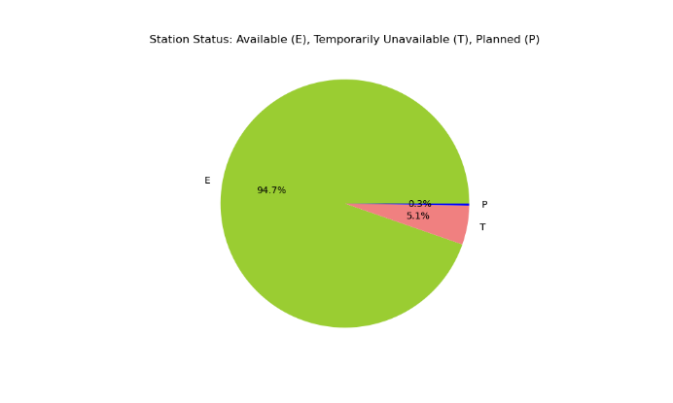
Overview of Alternative Fuel Stations – Station Status
Electric stations have the largest % of Temporarily Closed Stations among the alternative fuel types, for renovations and upgrades.
Larger percentage of Liquified Natural Gas and Hydrogen stations are planned to be open.

Slide 10
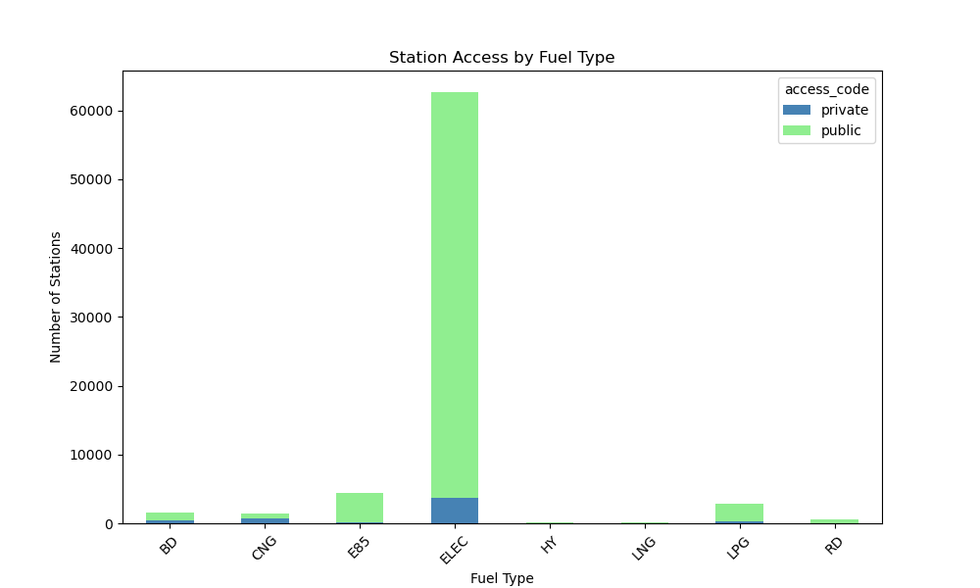
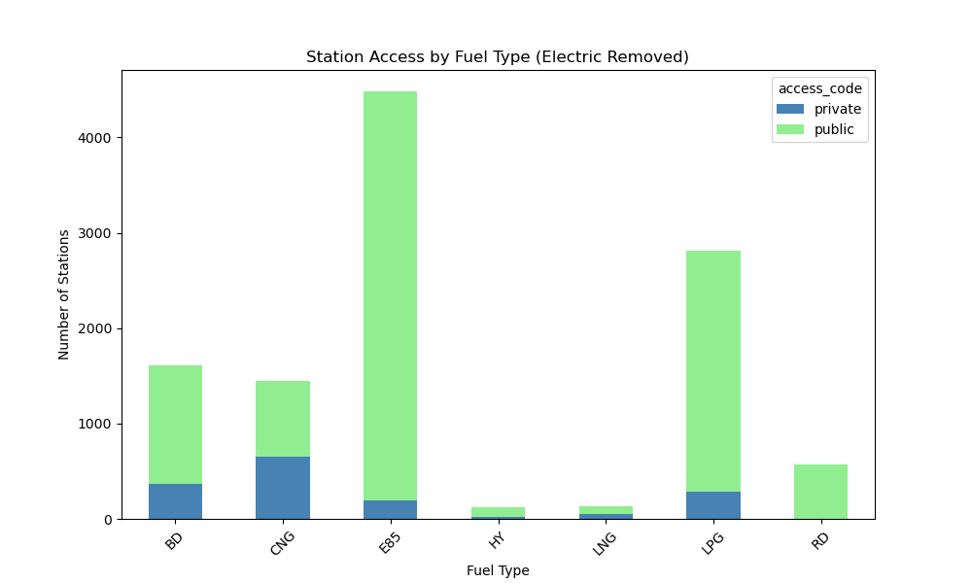
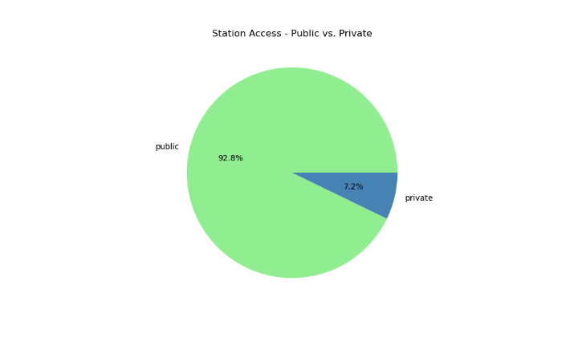
Overview of Alternative Fuel Stations – Station Access
Majority of the stations regardless of fuel type are accessible by the public (general consumers.)

Slide 11
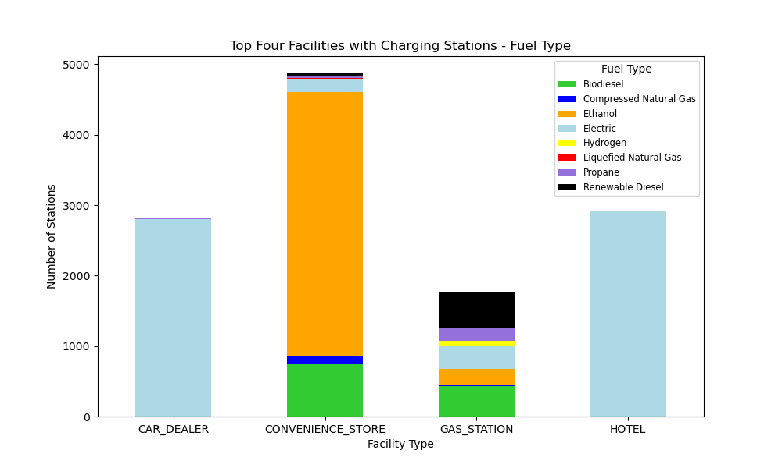
Overview of Alternative Fuel Stations – Type of Facility
Convenience Stores have the largest # of stations, while Hotels and Car Dealers have the largest # of Electric stations.
Gas Stations have the biggest variety of fuel type of stations.

Slide 12
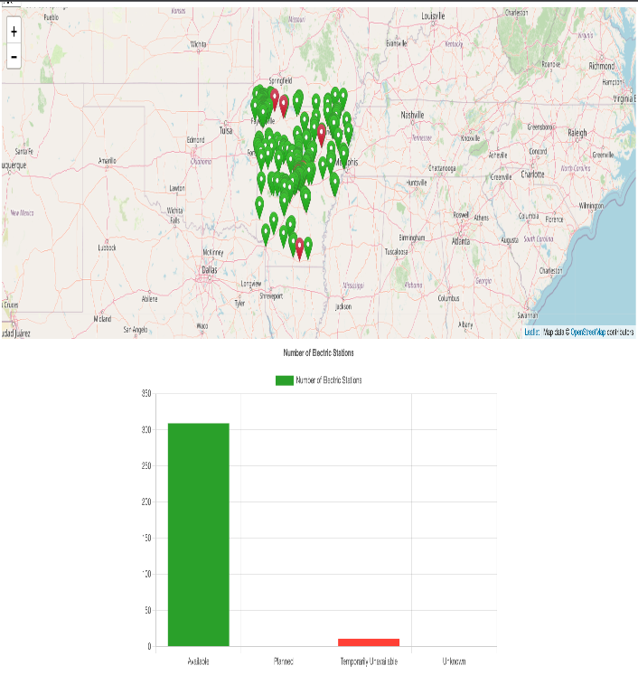
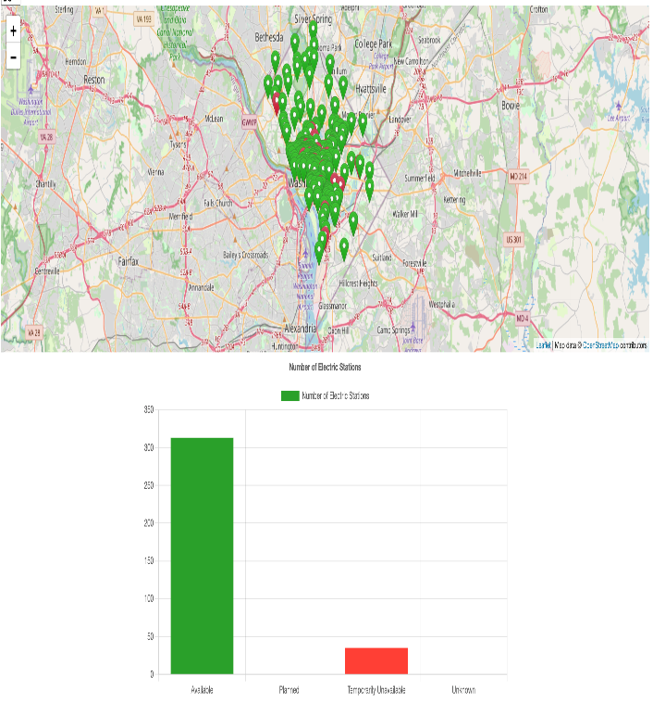
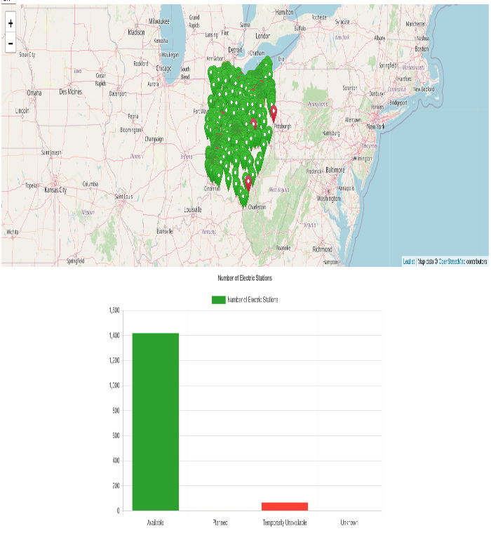
Mapping Visualization of Electric Stations – Station Status (LIVE)
The availability of stations is not correlated with the state’s population size or area, but rather with its populations’ political affiliation.
Arkansas
Washington DC
OHIO

Slide 13
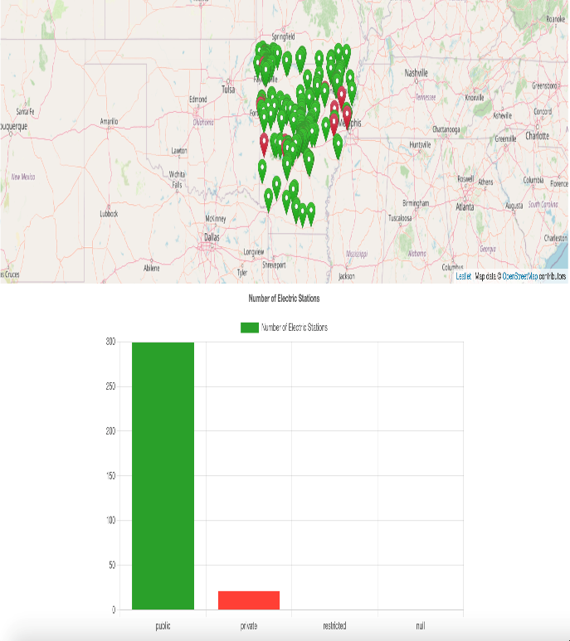
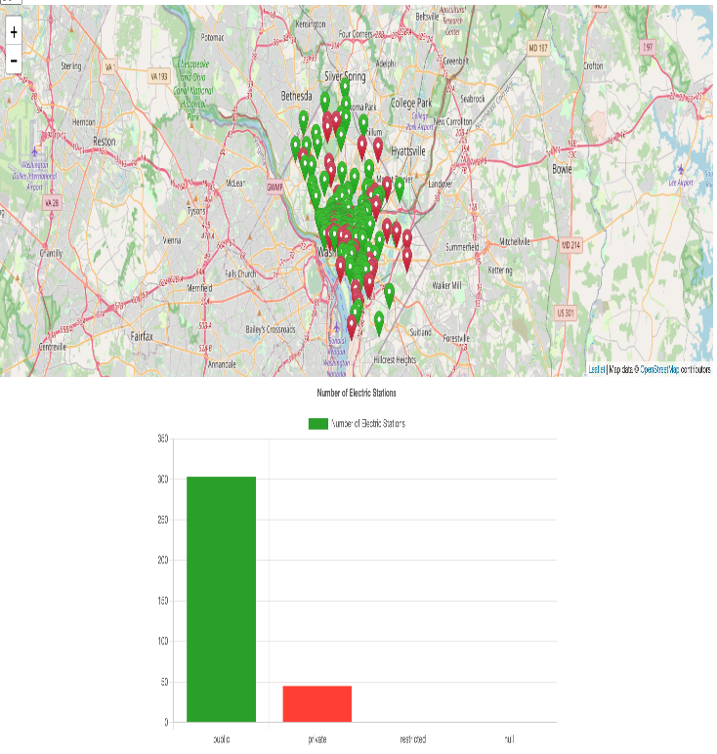
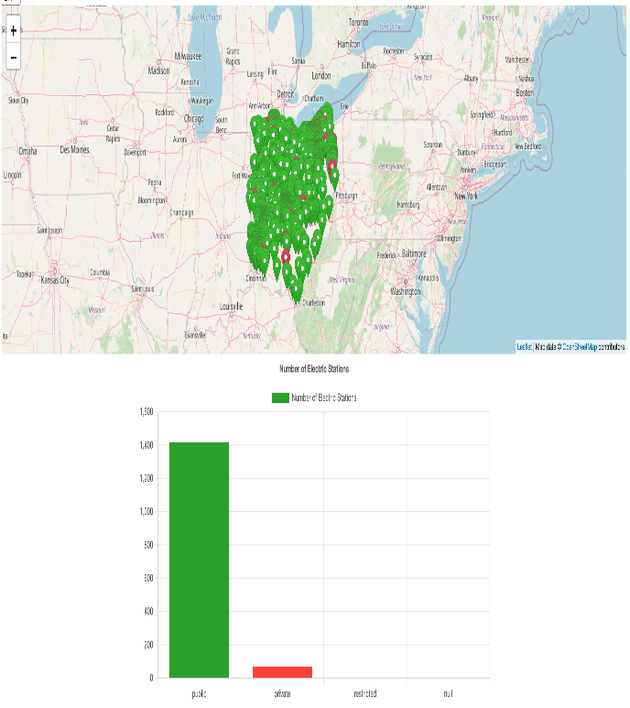
Mapping Visualization of Electric Stations – Station Access (LIVE)
The higher ratio of Private to Public stations in Washington D.C., in comparison to Arkansas and Ohio, is due to the presence of government and military facilities.
Arkansas
Washington DC
OHIO

Slide 14
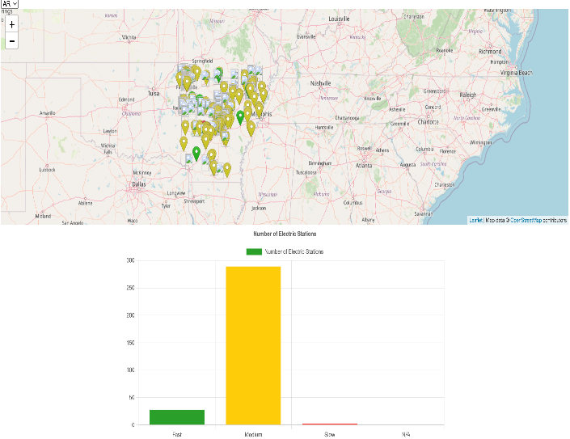
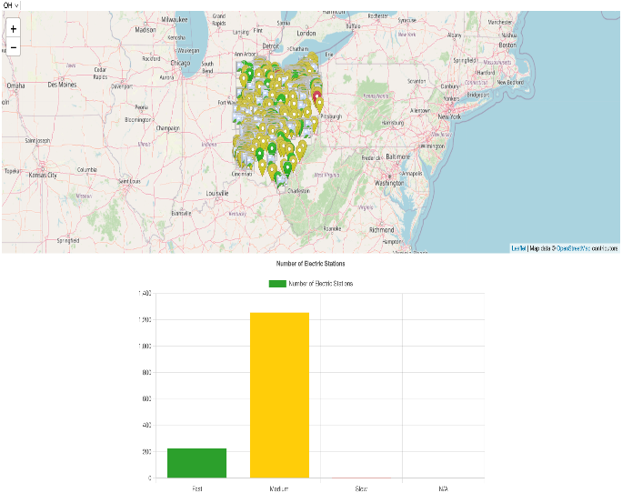
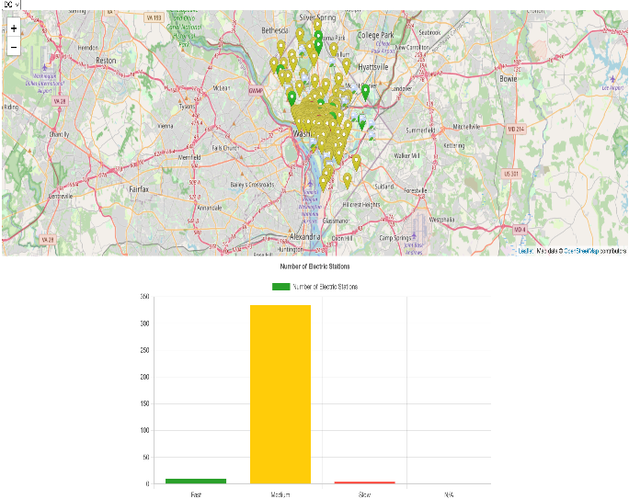
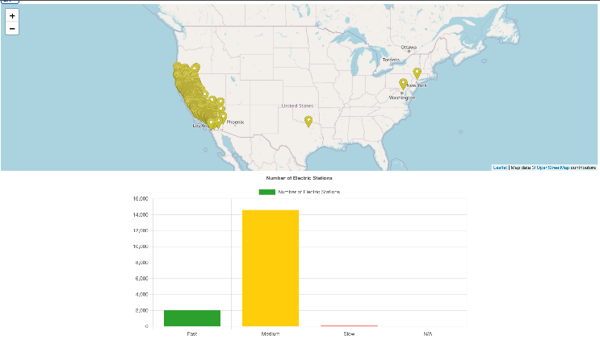
Mapping Visualization of Electric Stations – Charging Speed (LIVE)
Ohio has the highest % of fast speed chargers.
In Washington D.C. the fast chargers are more expensive to install & operate.
Arkansas
OHIO
Washington D.C.
California

Slide 15
Limitations, Challenges, and Further Analysis Recommendations
Data quality issues were mitigated as much as feasibility possible given the constraint of short turnaround time.
Further investigation of the association of alternative fuel supply and demand by political affiliation (such as, voter registrations) could provide valuable insights about the geographic prevalence of stations.
Further investigation of the potential triggers for higher demand for the different fuel types; such as, marketing campaigns, laws & regulations, and demographic characteristics (affluence, education, age).
Further comparative analysis of the reasons behind the variation in demand for the different fuel types over the years.
In-depth analysis of the reasons for building certain networks of stations and location placement, and whether they are equitable across all communities.

Slide 16
Q & A

Slide 17
APPENDIX

Slide 18
References
FuelEconomy.gov - The official U.S. government source for fuel economy information.
https://www.politico.com/2020-election/results/president/
https://www.chargepoint.com/blog/when-and-how-use-dc-fast-charging#:~:text=Because%20they%20provide%20more%20power,use%20fast%20charging%20every%20day.

